Slide 1
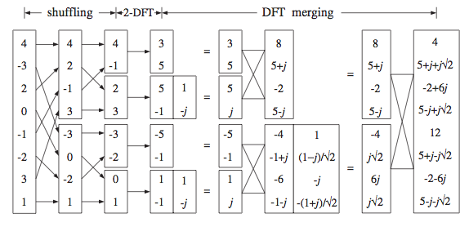
FFT (Decimation in Time)

Slide 2
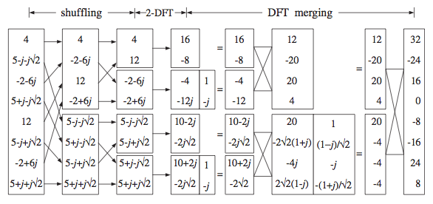
IFFT (Decimation In Time)

Slide 3

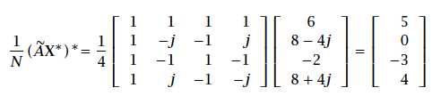
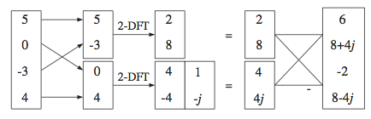
IFFT (intuition)

Slide 4



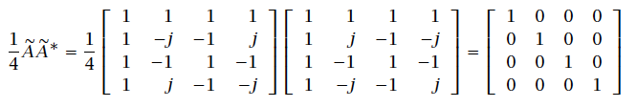





IFFT (Formal)

Slide 5
Z transform

Slide 6




Z- transform

Slide 7
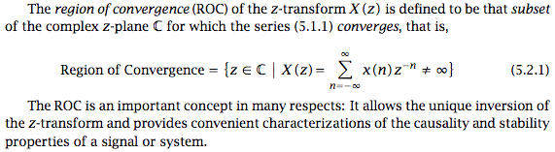
Z- transform: Region of Convergence

Slide 8






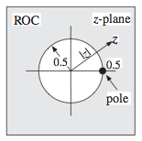

Z- transform: Region of Convergence

Slide 9


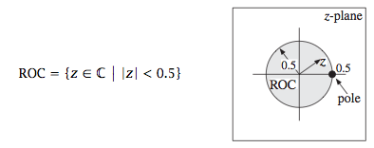

Z- transform: Region of Convergence

Slide 10

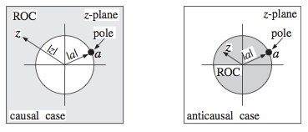
Z- transform: Region of Convergence

Slide 11
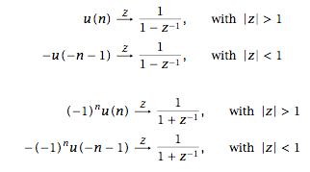
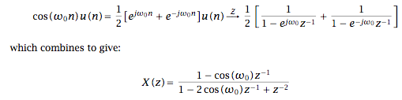
Z- transform: Region of Convergence

Slide 12

Inverse Z- transform

